Slide 1
Integrated Primary Care: Assessing primary care provider stress, psychological flexibility, and use of behavioral health services
Melissa Baker, PhD
Behavioral Health Consultant
HealthPoint
Bothell, Washington

Slide 2
Conflicts of interest to disclose
None

Slide 3
Objectives
A brief review of HealthPoint’s integrated behavioral health program
Discuss Provider Study
Present data from study
Discuss lessons learned and interventions implemented

Slide 4
HealthPoint
Founded in 1971
Largest Federally Qualified Health Center in King County Washington
Level 3 Patient-Centered Medical Home
12 locations
Integrated Medical, Dental, Pharmacy
2 School Based Clinics
Started Behavioral Health Program in 2000
BHC as each site; plus interns/practicum students

Slide 5
Integrated Behavioral Health
80% of PCPs visits are psychosocial driven
Primary Care Behavioral Health Model (PCBH)
Robinson & Reiter, 2015
Population-based care model
Consultant to PCMT
Brief visits
Collaborative
Catch patients in a teachable moment
Practice Change
(5th & 6th)
Shared practice space
Clinical: Tx plan; Shared EBPs
Care team: One stop shop
Organization support
Billing

Slide 6
Why do this study?
Working in primary care is very complicated, fast paced, and dynamic = STRESSFUL
Only 40% of US physicians are PCPs
Of younger PCPs, 30% plan to leave PC within 5 years
Of older PCPs, 27% plan to retire AND 25% to leave PC within 5 years
High burnout in primary care
Why?
Build professional resiliency and psychological flexibility

Slide 7
Why do this study?
Focus on integration
How can BHCs support/assist PCPs with their own well-being to reduce the burden?
PCPs value the work- How do we reconnect them to values?
What do PCPs value within the PCBH model?
As a BHC, how can I better….
Teach
Collaborate
Reach the population

Slide 8
Study Design
Phase I
Online Survey to medical providers
Phase II
4 BHC providers paired with 2 medical providers (MD, DO, NP)
BHCs work side by side with PCMT for 1 full week
Goal to collaborate on as many patients as feasible
Direct patient care
Indirect patient care

Slide 9
Provider Study
Primary Care Provider Stress- Checklist
37 items
6 stress domains: patient interactions, practice management, administrative issues, education/learning, relationships with colleagues, and work-life balance
Total score; domain score
PCP AAQ-II
20items
AAQ-II
O’Donohue’s Behavioral Health Satisfaction Survey
Likert scaling about BHC services

Slide 10
Provider Demographics
57 providers (50 completed entire survey)
Majority (N = 37) MDs
Majority early in their careers
0 – 5 years = 22
6 – 10 = 11
11 – 15 = 10
16+ = 13

Slide 11
Provider Study
Increases in flexibility, stress levels decrease
PCP-SC (p < .01; r = -.52) with PCP-AAQ
Increases in flexibility, stress levels decrease
PCP-SC (p < .01; r = .60) with AAQ - II
Providers’ satisfaction with BH increases, their stress decreases
PCP-SC (p < .01; r = -.40) with BH satisfaction survey
PCP-AAQ accounted for 27% of the variance (p < .000)
Control for degree type (i.e., MD, DO, NP), the variance is 30%

Slide 12
BH Satisfaction
100% satisfied with BH
34 = Strongly Agree (68%); 16 – Somewhat Agree (32%)
100% recommend having BH services
47 = Strongly Agree (94%); 3 = Somewhat Agree (6%)
100% believe referral process easier
48 = Strongly Agree (96%); 2 = Somewhat Agree (4%)
84% agree patients more compliant
17 = Strongly Agree (34%); 25 = Somewhat Agree (50%)
100% agree having BH makes job easier
45 = Strongly Agree (90%); 5 = Somewhat Agree (10%)

Slide 13
Implications
Psychological flexibility in PCPs
Important to assist PCPs in building psychological flexibility
Decrease stress, burnout
Longevity!
PCPs like having BHC services ☺
How do you discuss psychological flexibility with medical providers?
Post- study presentation to providers
State versus trait
Brainstorming began….
Provider meetings
Online modules
Handouts

Slide 14
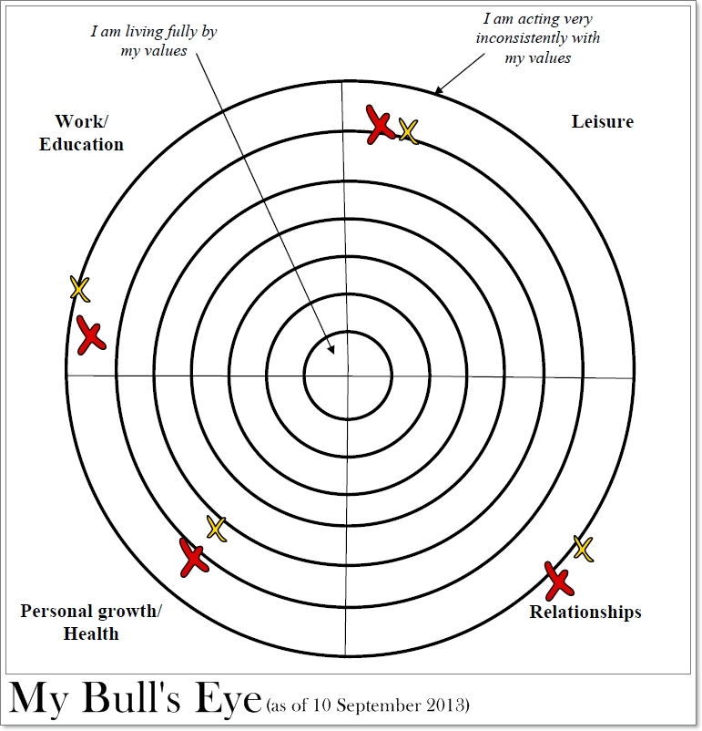
Implications
ACT Bullseye Activity
Quarterly at PCP meetings
Timeline activity
PCP group
Teach Mindfulness
Online modules on mindfulness exercises
Choice Point/Matrix Activity
Fully integrated BHCs

Slide 15
Provider Statement
1st job ARNP- “I really liked the bullseye activity. As a new provider I felt the pressure ! I came to community health for the mission and found myself lost in productivity goals and cursing the electronic medical record. This activity helped me think about deep down what is important to me. It opened my eyes to the imbalance I had created in my work life, but also in other life domains.”

Slide 16
Acknowledgement
HealthPoint Bothell
David Bauman, PsyD
Bridget Beachy, PsyD

